Slide 1

How Quick is Quic?

Slide 2

Introduction
Huge amounts of data in the current world, need faster networks for the same.
Inability of HTTP to work at such high speeds.
HOL Blocking
Higher RTT for handshakes especially for TLS
Solution - Quic:
Connectionless (UDP)
Lesser RTT due to lesser handshakes
Packet Pacing
Forward Error Correction (FEC)

Slide 3
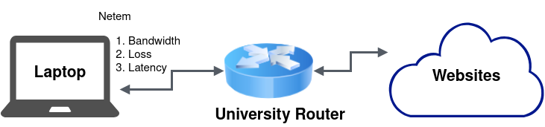
Test Setup
Client | Server
Mac(M1, 16GB), Ubuntu(NVidia RTX2070, 32GB), Ubuntu(NVidia GTX1660, 8GB), and University wifi Data combined and analyzed later | 20 Websites that supported Quic were used. Captured using Har
Websites chosen are mostly from either of Google, Facebook or Cloudflare’s domains as these are the major ones that support Quic

Slide 4
Evaluation (Testing Environment)
Parameter Type | Parameter | Values tested
Network | Bandwidth | [2Mbps, 10Mbps, 50Mbps]
 | Loss rate | [0%, 2%]
 | Latency | [1ms, 100ms]
Webpage | Webpage Size | [0.5 MB, 1.5 MB, 2.5 MB] {small, medium, large}
 | Object Type | CSS, HTML, IMAGE, JS
Performance metrics:
Page load time (PLT) – Time taken for a web page to load along with all of its resources
Time to first byte – Determines the connection speed
Measurement Tools:
Chromium Browser : Headless version of the chromium browser is spawned from the python code; this acts as the client for the QUIC and HTTP2 protocols
HAR Capturer : Captures all the logs from chromium browser when interacted with sites

Slide 5
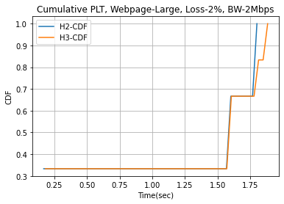
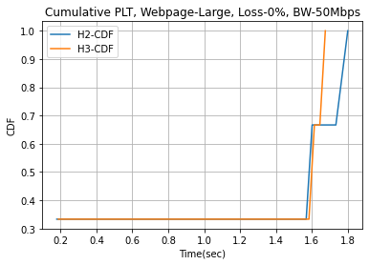
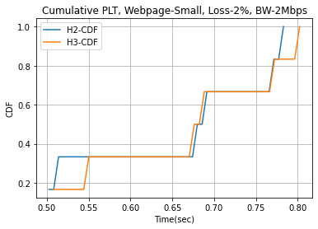
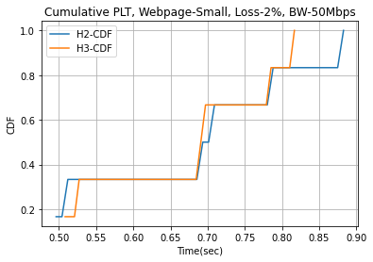
Analysis – Page load time
Figure shows the web page load time of QUIC and HTTP2 for small and large web page under different network conditions.
Although it is expected that QUIC provides better performance under high loss rate and when the Bandwidth is low.
But our experiments reveal that both QUIC and HTTP2 provide comparable performance

Slide 6
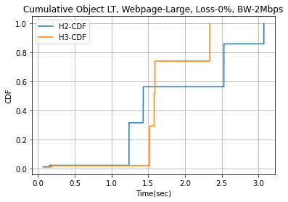
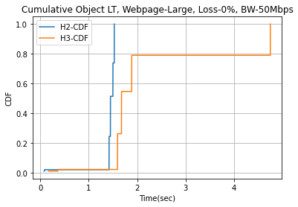
Analysis – Object load time
Figure shows the Object load time of QUIC and HTTP2 when the loss rate is 0 and with the varying Bandwidth.
It can be inferred that under lower bandwidth QUIC provides better results and when the bandwidth increases HTTP2 provides better results as compared to QUIC

Slide 7
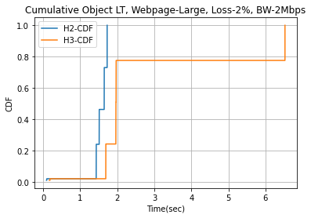
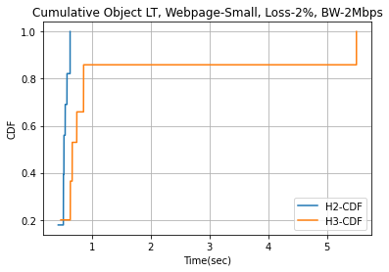
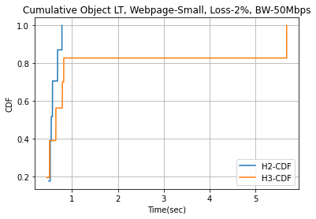
Object load time for loss = 2%
From the above experiments we see that both QUIC and HTTP2 provide comparable results for loadind the object when with higher.

Slide 8
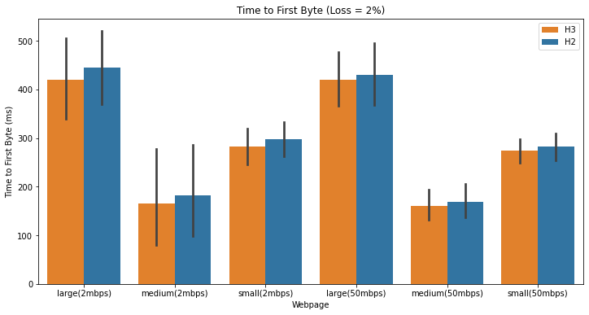
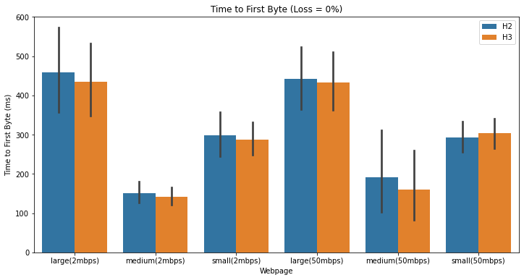
Analysis – Time to first byte
Although Quick is expected to perform better here, since it uses 0-RTT connection. Ours experiments revealed that the gain is neglibile

Slide 9
Conclusion
From our analysis, it is shown that gain when using QUIC is high only when the bandwidth is low
In all other scenarios, we see that QUIC provides comparable results to that of HTTP2
Since our analysis was on 20 websites mainly from Facebook, Google and Cloudflare domains. Further analysis is required to conclude which protocol performs better based on the given scenario

